Slide 1
Name: Varun Marulkar Project No 157

Slide 2


ASD: Data Driven Analytics

Slide 3

Project Leadership
Sharat Manikonda
Director at Innodatatics and Sponsor
linkedin.com/in/sharat-chandra

Slide 4

Contents
Project Overview and Scopes
Business Problem
Business Objective and Constraint
Crisp ML (Q) Methodology Technical Stacks
Project Architecture
Data Collection and Understanding
Data Information
Data Dictionary Exploratory Data Analysis
Data Preprocessing
Visualization
Business Insights
Challenges
Future Scope
Notes:
Change

Slide 5
Project Overview and Scope
Title: ASD Data Driven Analytics
Start Date: 31 December 2023
Expected Completion Date: 30 January 2024
Organization: 360DigitMG
ASD data driven analytics project at 360DigitMG is initiated to address the business problem of frequent manual stored checks of pallets.

Slide 6
Contents
Project Overview and Scopes
Business Problem
Business Objective and Constraint
Crisp ML (Q) Methodology Technical Stacks
Project Architecture
Data Collection and Understanding
Data Information
Data Dictionary Exploratory Data Analysis
Data Preprocessing
Visualization
Business Insights
Challenges
Future Scope
.

Slide 7
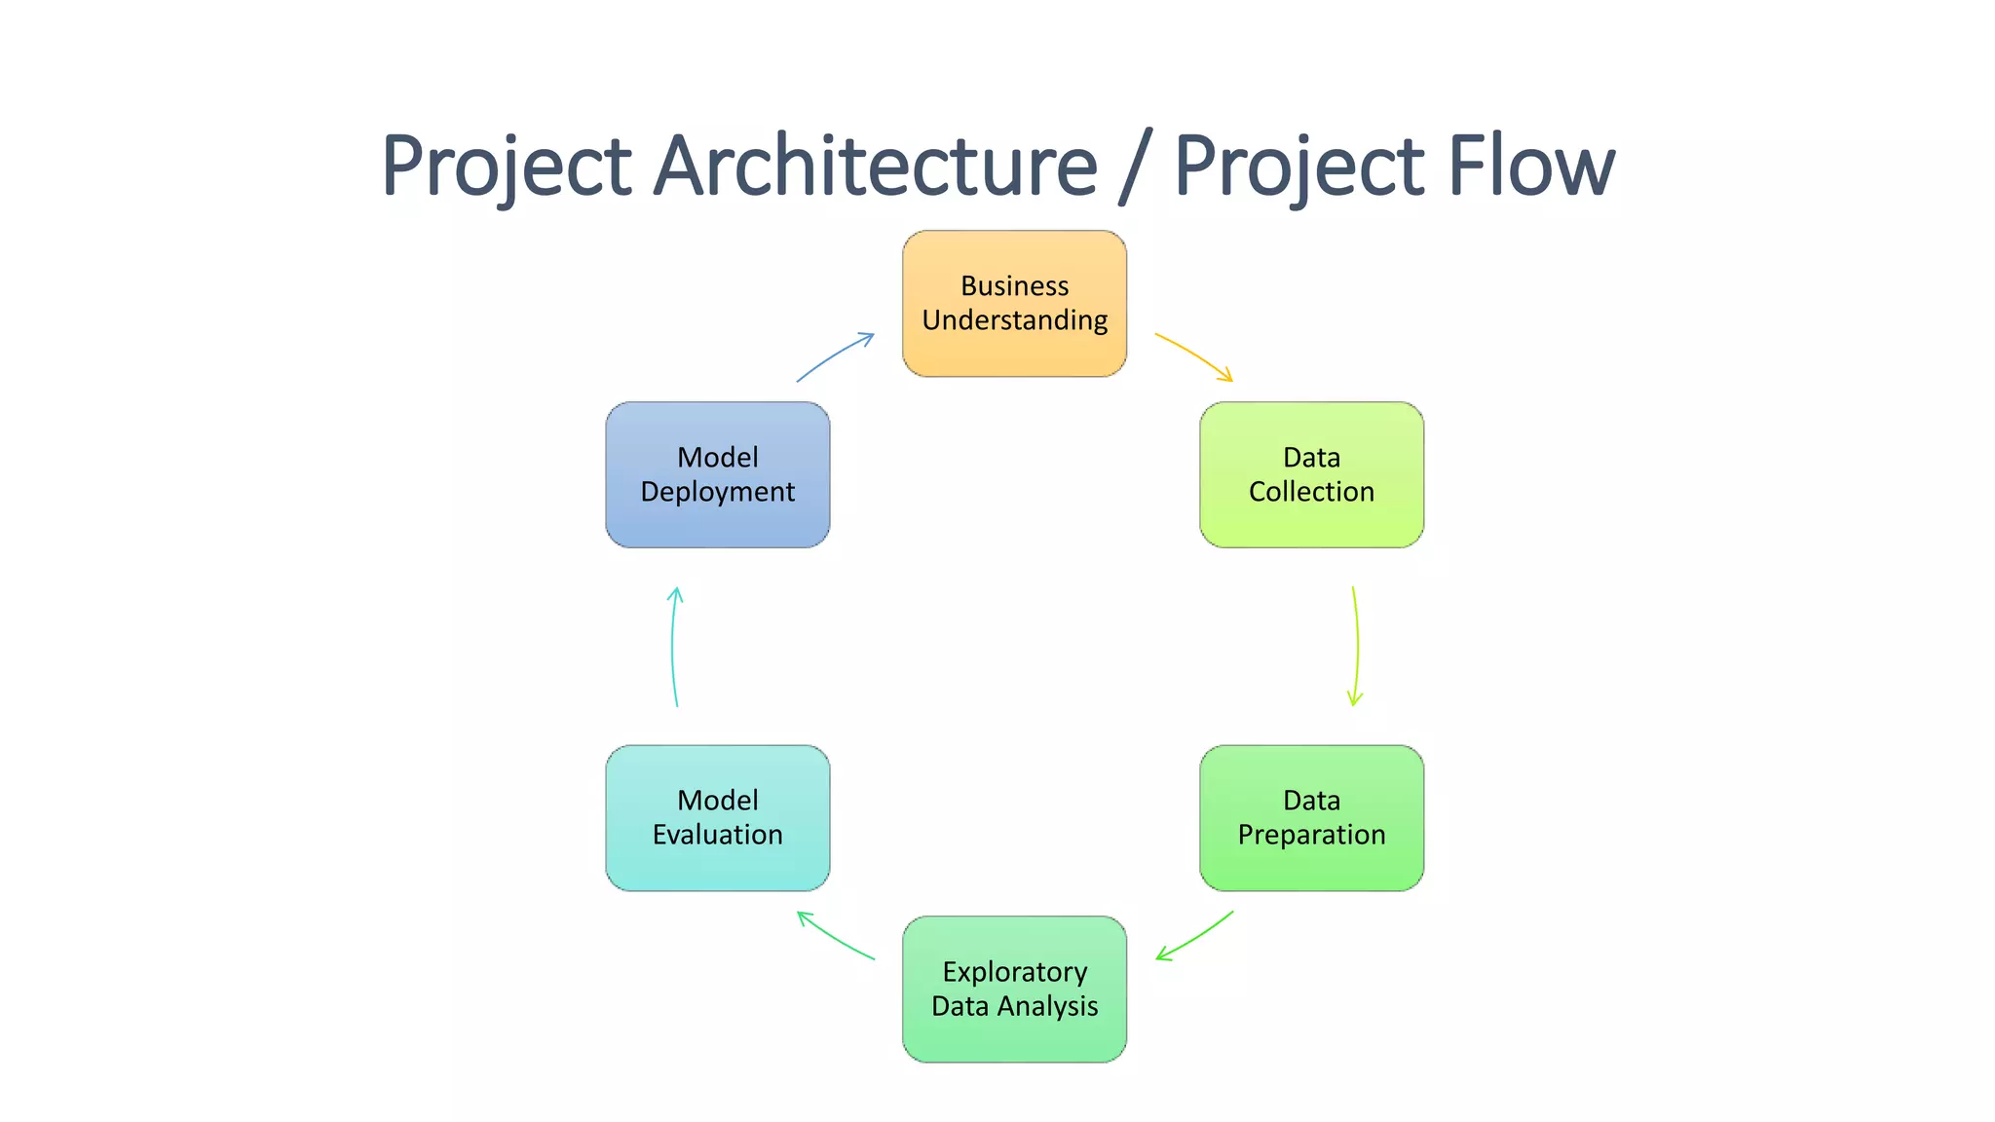
Project Overview and Scope

Slide 8
Business Problem
While videos are captured, what kind of insights and dashboards can be generated using the data extracted from video analytics is still unclear.

Slide 9
Business Objective
Maximize the effective utilization of data.
Business constraint:
Minimize usage of manual creation of reports.

Slide 10
CRISP-ML(Q) Methodology
There are six stages of CRISP-ML(Q) Methodology
1.Business and data understanding
2.Data preparation
3.model building
4.Model evaluation
5.Model deployment
6.Monitoring and maintenance

Slide 11
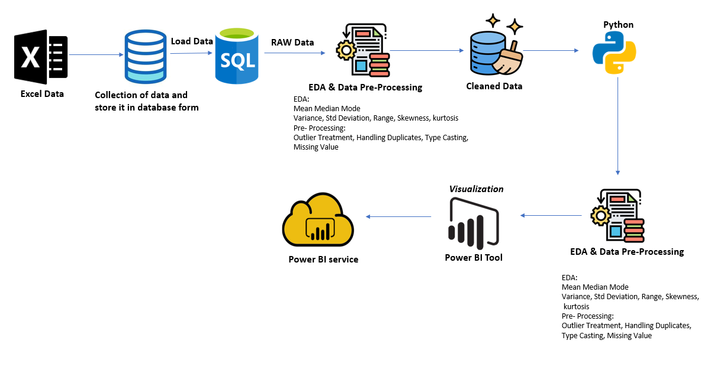
Project Architecture
Notes:
classification is the task of predicting a discrete class label. Regression is the task of predicting a continuous quantity.
What is classification techniques in machine learning?
The Classification algorithm is a Supervised Learning technique that is used to identify the category of new observations on the basis of training data. In Classification, a program learns from the given dataset or observations and then classifies new observation into several classes or groups.
What is regression techniques in machine learning?
Regression is a technique for investigating the relationship between independent variables or features and a dependent variable or outcome. It's used as a method for predictive modeling in machine learning, in which an algorithm is used to predict continuous outcomes.

Slide 12
Data Collection and Understanding
Data was collected from multiple sources using google scholar.
Websites like Elsevier.org. Wiley Online Library, academia.edu etc.
The extracted data was mapped with the data provided by client.
After mapping the data, the extracted data and client's data was mapped so as to obtain the final raw data.
The data comprised of columns related to Date, Customer Name, intermediate outputs like Quantity etc.
The final output characteristic was found to be Transaction Type

Slide 13
Data Information
Categorical Variables Those that can take on a limited and usually fixed number of possible values or categories.
user_name
Discrete Variables :These are variables that can only take specific values (often whole numbers) and not any value within a range. Examples : class_name

Slide 14
Data Dictionary
data.xlsx
Column name | Description | Description
uid | Unique Id | Unique Id
asd_project34_video_id | video_id from video_details.xlsx | video_id from video_details.xlsx
user_name | name of the autistic kid | name of the autistic kid
duration | exact time stamp of that frame in seconds | exact time stamp of that frame in seconds
class_name | the behavior that a child is exhibiting | the behavior that a child is exhibiting
probability | probability of that particular class that a person is exhibiting | probability of that particular class that a person is exhibiting
fps | frame per second as per the asd_project34_video_id | frame per second as per the asd_project34_video_id
data_time | data and time stamp when that particular frame is analyzing | data and time stamp when that particular frame is analyzing
Note: Each row represents a frame with respect to a particular person
video_details.xlsx
Column name | Description
video_id | unique id for a particular video
name | name of the video
length | entire duration for a particular video

Slide 15
Exploratory Data Analysis [EDA]
1.EDA is a process of investigating data to learn about its properties, spot unusual patterns, and test hypotheses. It uses statistical summaries and data visualizations to help us understand the data and make informed decisions.
2. EDA is the first step in data analysis, where we explore the data to learn about its patterns, relationships, and anomalies
3. There were 0 duplicate rows in the dataset.
Notes:
EDA is used for seeing what the data can tell us before the modeling task.
Change

Slide 16
Missing Values Observation
No missing values found in any column of these 2 tables..
Data
Duration=0 missing values
Probability=0 missing values
fps=0 missing values
asd_project34_video_id=0 missing values
Class Name=0 missing values
Date time=0 missing values
Video
Length= 0 missing values

Slide 17
Data Preprocessing
The data was first cleaned by checking and correcting the data types, filling in any missing values. Then, outliers were detected and handled. Data preprocessing have performed in SQL and in Python EDA.
SQL:
1. Data type correction: The data types of all attributes were checked and corrected, if necessary.
2. Missing value detection: No missing values were found in any column.
3. Outlier detection: Outliers were detected in each attribute by using IQR Method and outliers found in Probability column from Data Table.
4. Outlier treatment: Outliers in the identified columns were treated using the Quantiles Method and successfully handle the threeshold of outliers in probability column on the data.
Notes:
Keep observations

Slide 18
Data Preprocessing
Python EDA:
1. Data type correction: The data types of all attributes were checked and corrected, if necessary.
2. Missing value detection: No missing values were found in any column.
3. Outlier detection: Outliers were detected in each attribute by using BoxPlot Method and outliers found in Probability column from Data Table.
4. Outlier treatment: Outliers in the identified columns were treated using the Winsorization Method and successfully handle the threshold of outliers in probability column on the data

Slide 19
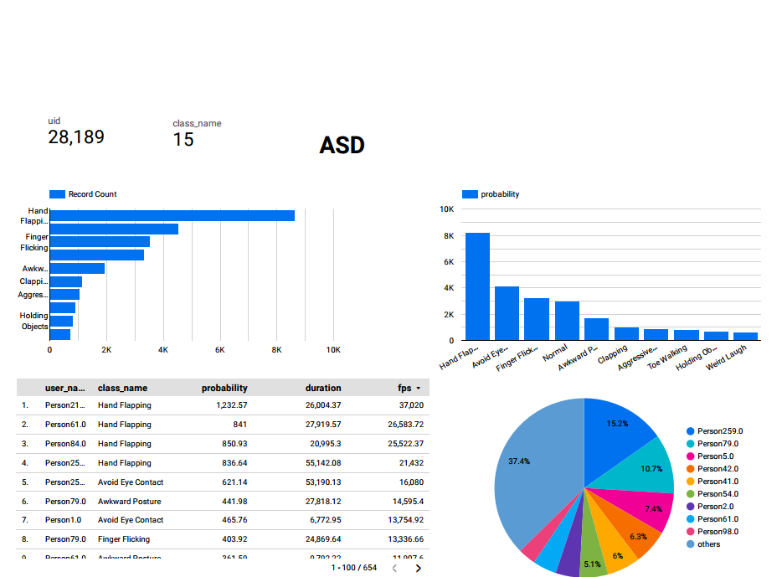
Data Visualization
Google Locker Room
Notes:
Add graphical

Slide 20
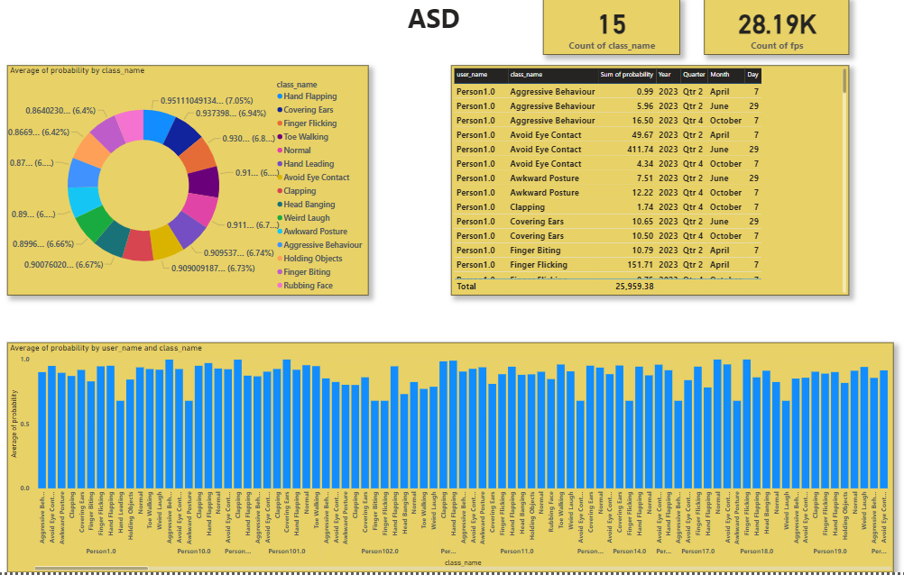
Data Visualization
PowerBi
Notes:
Add graphical

Slide 21
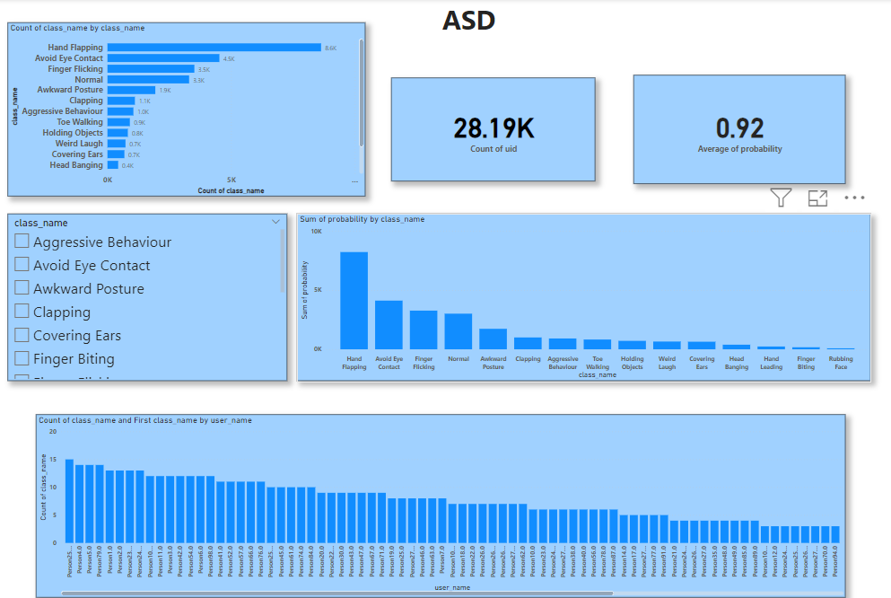
Data Visualization
Notes:
Add graphical

Slide 22
Challenges
Data Quality and Availability: Limited availability and quality of ASD-related datasets.
Data Privacy and Ethics: Ensuring privacy and ethical considerations when handling sensitive information about individuals with ASD.

Slide 23
Future Scopes
The future scope of ASD (Autism Spectrum Disorder) data-driven analytics holds significant potential for advancing our understanding of ASD, improving diagnostic methods, and enhancing interventions.

Slide 24

Queries ?

Slide 25


